Slide 1
Object Oriented Programming in Java :
Java characteristics, Classes and Objects, Methods and Constructors. Information hiding: access modifiers, Static keyword: class variables and instance variables, Class methods and instance methods.

Slide 2
Java
Java is a multi-platform, object-oriented, and network-centric language.
It is among the most used programming language

Slide 3
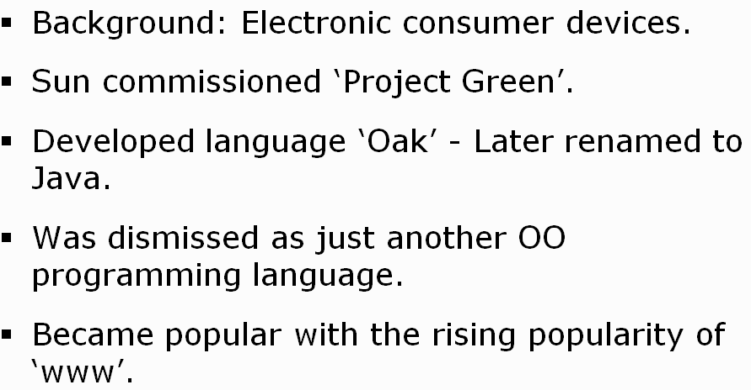
History of Java
James Gosling developed the Java platform at Sun Microsystems, and the Oracle Corporation later acquired it.

Slide 4
What is Java used for?
It is used for developing Android Apps
Helps you to create Enterprise Software
Wide range of Mobile java Applications
Scientific Computing Applications
Use for Big Data Analytics
Java Programming of Hardware devices
Used for Server-Side Technologies like Apache, JBoss, GlassFish, etc.

Slide 5
Features of Java
Simple
Object-Oriented
Platform independent
Secured
Robust
Multithreaded
Distributed
Dynamic

Slide 6
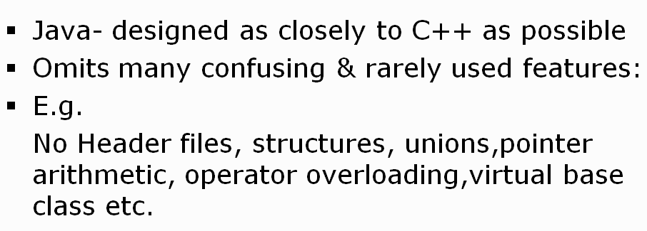
Simple
Java is very easy to learn,
syntax is simple, clean and easy to understand.

Slide 7
Contd..
Platform Independent
A platform is the hardware or software environment in which a program runs.
C, C++, etc. which are compiled into platform specific machines
Java is a write once, run anywhere language.(WORA)
Java code is compiled by the compiler and converted into bytecode.
This bytecode is a platform-independent code because it can be run on multiple platforms,

Slide 8
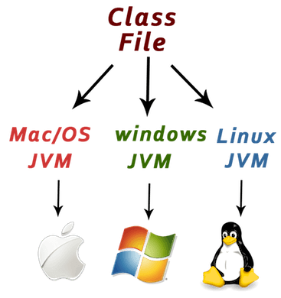
Contd…

Slide 9
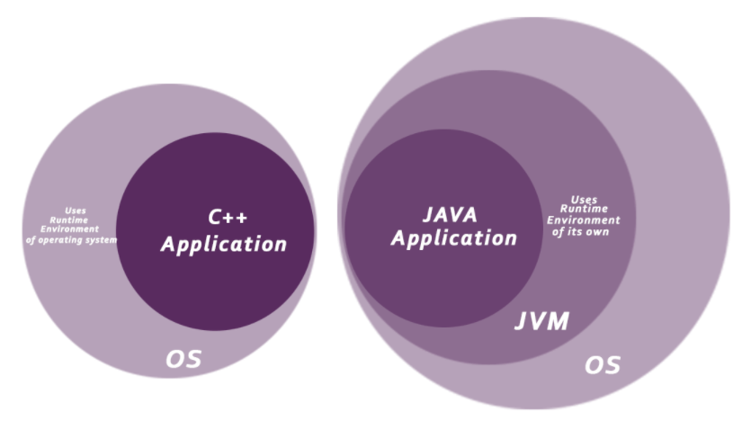
contd..
Secure
Java is best known for its security.
Java Programs run inside a virtual machine sandbox

Slide 10
Contd…
Robust
Robust simply means strong.
Java is robust because:
It uses strong memory management.
No pointers that avoids security problems.
automatic garbage collection
exception handling
Developers doesn't worry about –
Bad pointer
Memory allocation errors and memory leakage

Slide 11
Contd…
Distributed
it facilitates users to create distributed applications in Java.
RMI and EJB are used for creating distributed applications.
This feature of Java makes us able to access files by calling the methods from any machine on the internet.

Slide 12
Contd…
Multi-threaded
A thread is like a separate program, executing concurrently.
We can write Java programs that deal with many tasks at once by defining multiple threads.
The main advantage of multi-threading is that it doesn't occupy memory for each thread.
It shares a common memory area. Threads are important for multi-media, Web applications, etc.

Slide 13
Contd…
Dynamic
Java is a dynamic language.
It supports dynamic loading of classes. It means classes are loaded on demand.
It also supports functions from its native languages, i.e., C and C++.
Java supports dynamic compilation and automatic memory management (garbage collection).

Slide 14
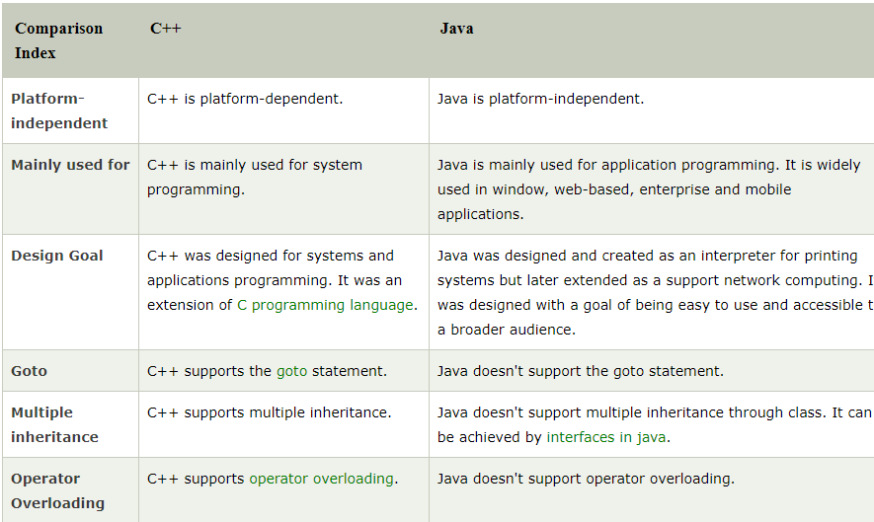
C++ vs Java

Slide 15
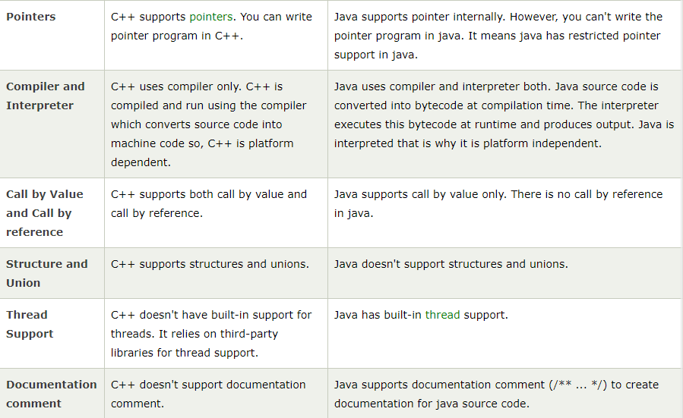
Contd…

Slide 16
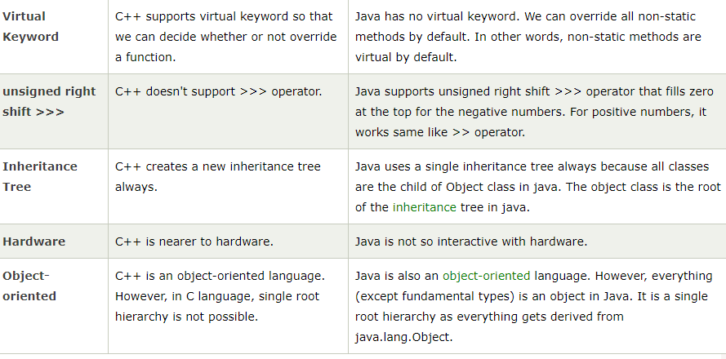
Contd…

Slide 17
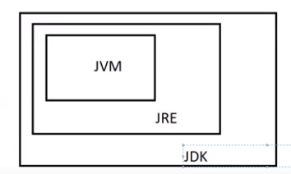
Components Of Java Programming Language
Java Development kit (JDK)
Java Virtual Machine (JVM):
Java Runtime Environment (JRE)

Slide 18
Java Development kit (JDK)
JDK is a software development environment used for making applets and Java applications.
JDK helps Java developers to code and run Java programs.
JDK contains tools required to write/develop the Java programs and JRE to execute them.
It includes a compiler, Java application launcher, Appletviewer, etc.
Compiler converts code written in Java into byte code.
Java application launcher opens a JRE, loads the necessary class, and executes its main method.

Slide 19
Java Runtime Environment (JRE)
JRE is a piece of software that is designed to run other software.
It contains the class libraries, loader class, and JVM.
to run Java programs JRE must be installed .

Slide 20
Java Virtual Machine (JVM)
Java Virtual Machine (JVM) is an engine that provides a runtime environment to for Java Code or applications.
It converts Java bytecode into machine language.
JVM is a part of the Java Run Environment (JRE).
In other programming languages, the compiler produces machine code for a particular system.
But the Java compiler produces code for a Virtual Machine known as Java Virtual Machine.
JVM is platform dependent.

Slide 21
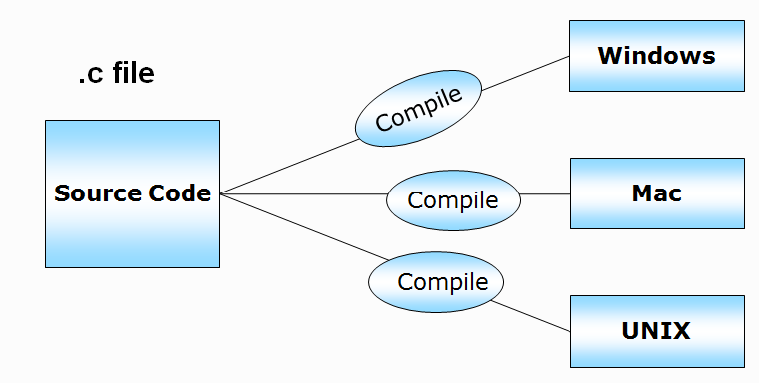
C program Execution

Slide 22
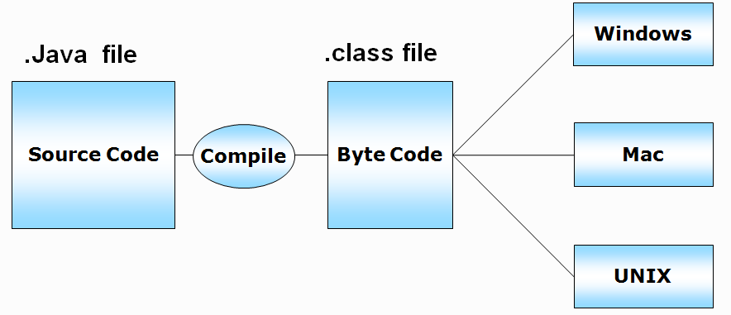
Java Program Execution

Slide 23
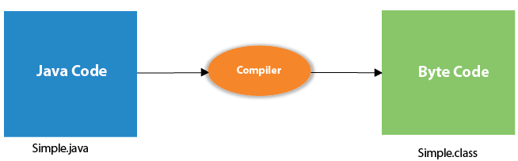
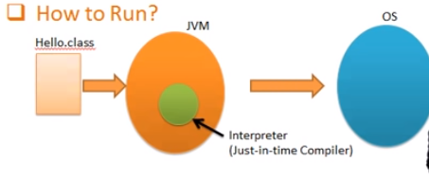
Contd…
What happens at compile time?
What happens at runtime? (java simple)

Slide 24
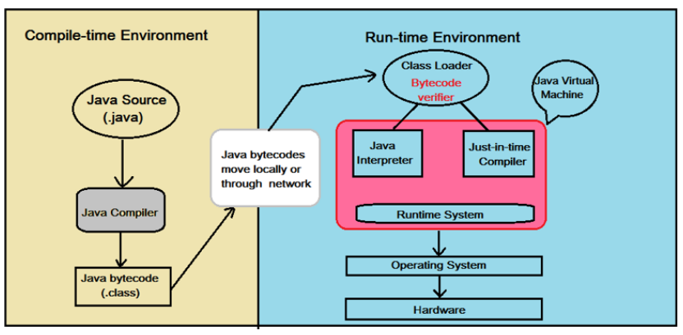
Contd…

Slide 25
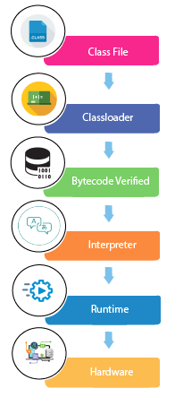
At runtime, following steps are performed:
Classloader: is the subsystem of JVM that is used to load class files.
Bytecode Verifier: checks the code fragments for illegal code that can violate access right to objects.
Interpreter: read bytecode stream then execute the instructions.

Slide 26
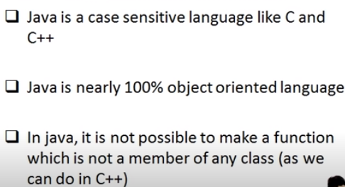
First program in Java

Slide 27
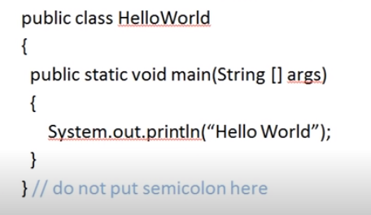
Creating Hello World Example
HelloWorld.java

Slide 28
Parameters used in Java Program
class keyword is used to declare a class in java.
public keyword is an access modifier which represents visibility. It means it is visible to all.
static is a keyword.
there is no need to create an object to invoke the static method.
The main method is executed by the JVM, so it doesn't require to create an object to invoke the main method. So it saves memory.

Slide 29
Contd…
void is the return type of the method. It means it doesn't return any value.
main represents the starting point of the program.
String[] args is used for command line argument.

